Slide 1
Flip book
G. Martinez

Slide 2
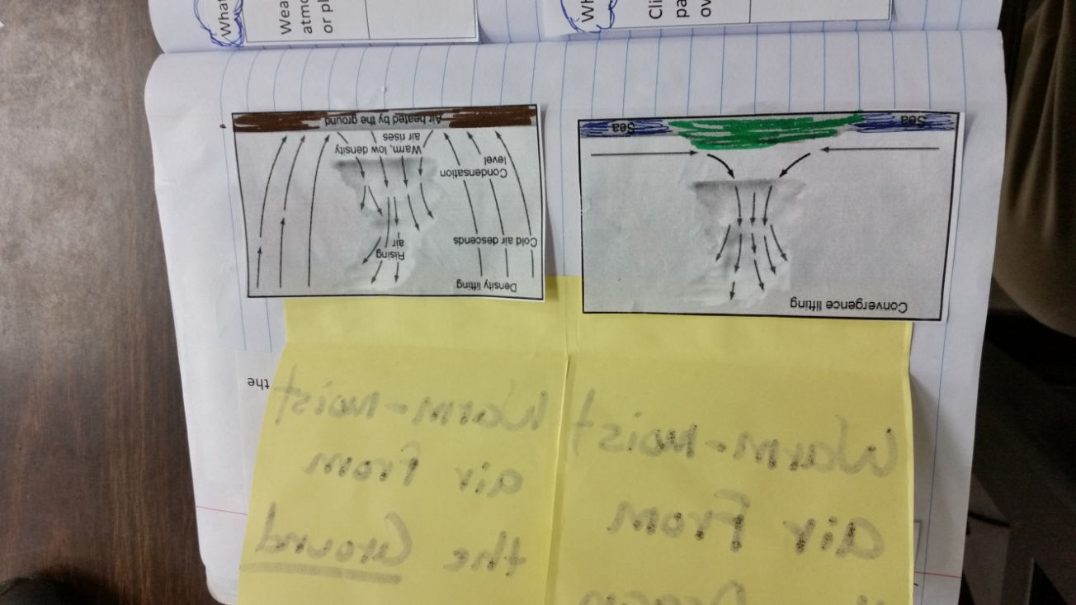
These are the pictures that go below the flip book

Slide 3
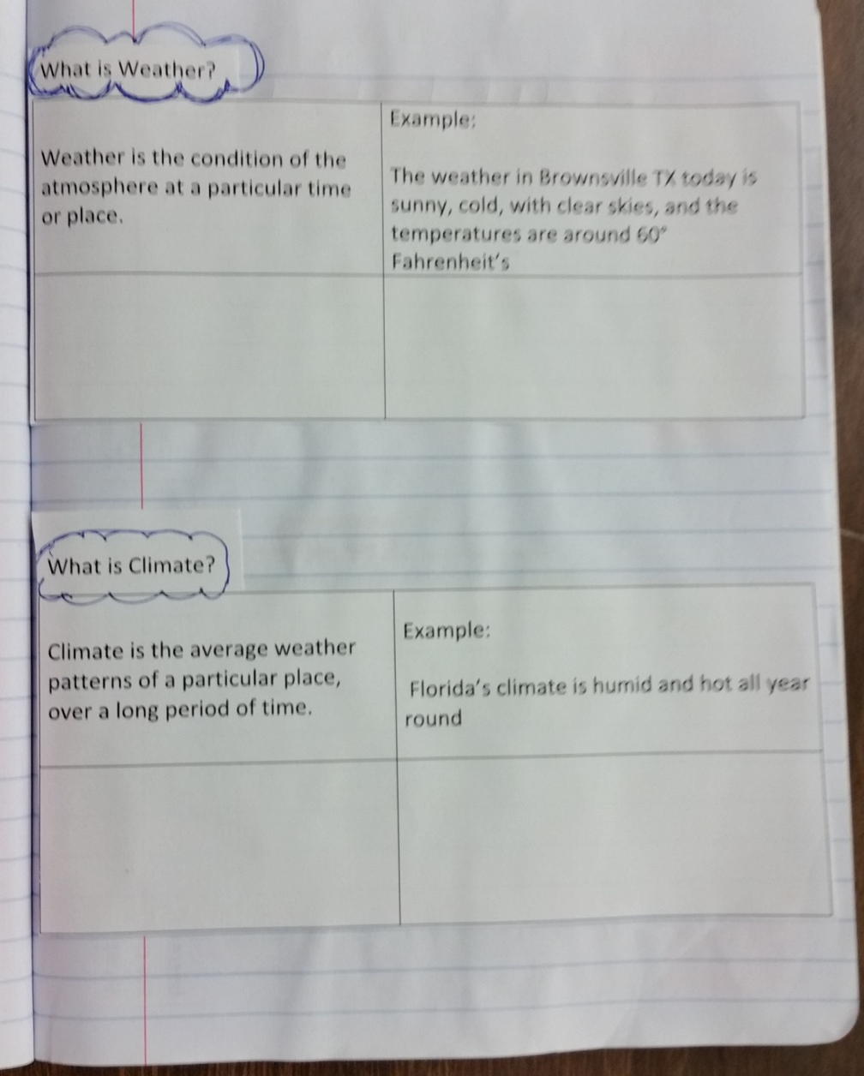
This page has to be completed. Provide two examples of weather for the first data-table and two more examples for climate for the second data table.

Slide 4
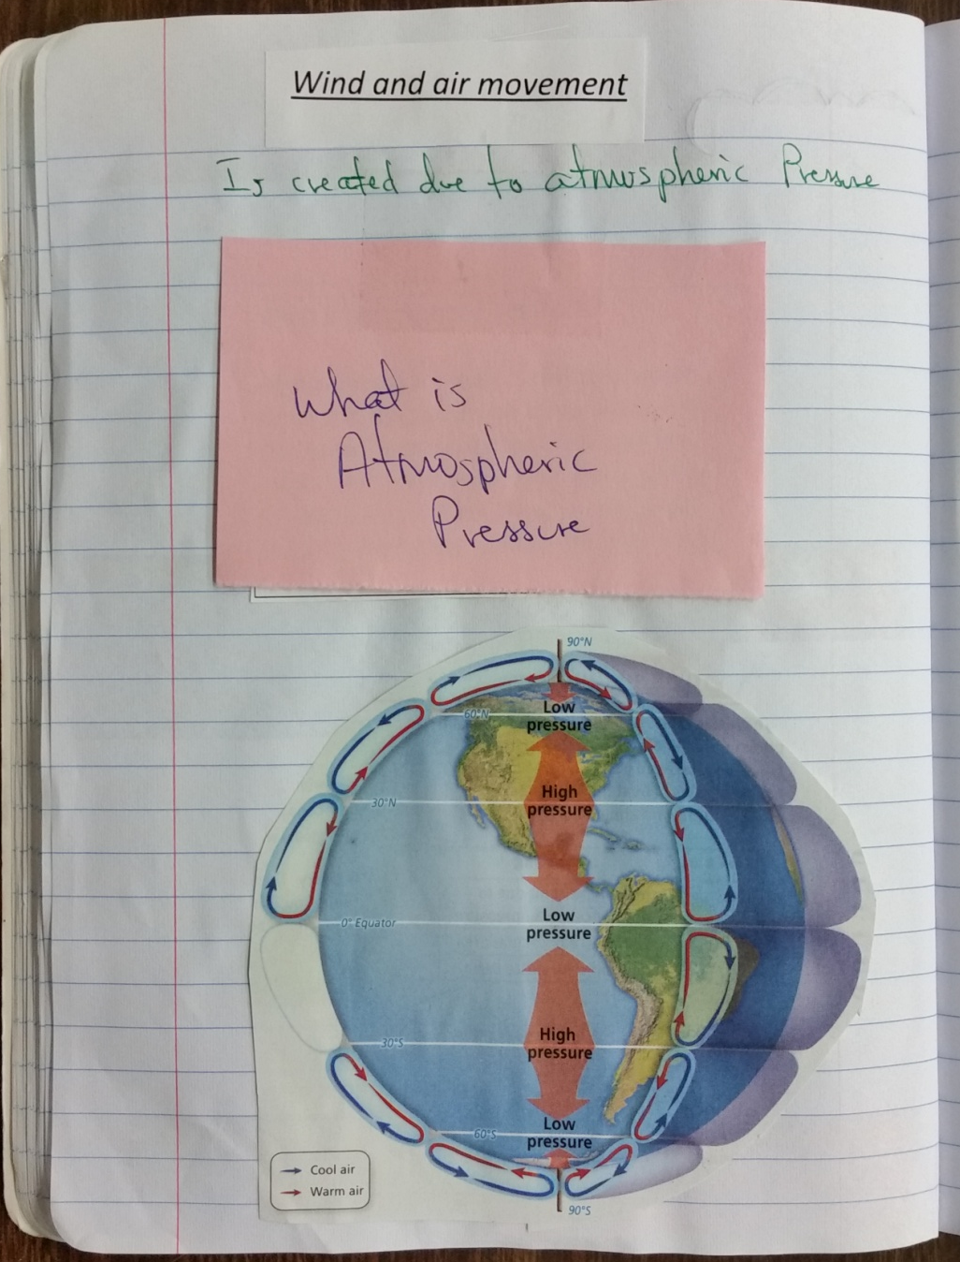
This is the information that goes inside this flip book. The picture of the planet with high and low pressure areas was taken from the science book (pg 424)

Slide 5
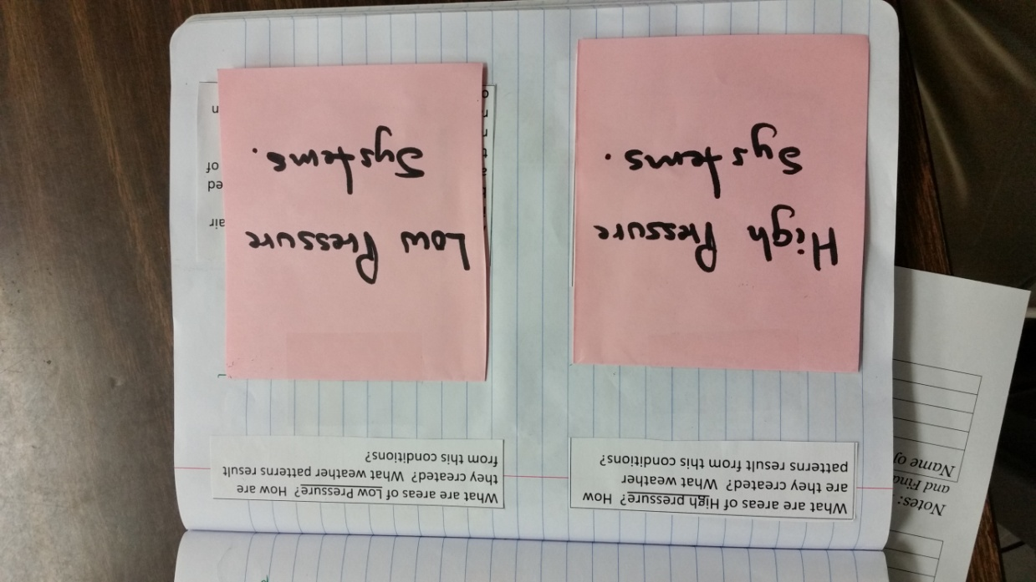
Each picture states if it is a low or high pressure systems, match them appropriately to each flip book. Also, read and match the information where it belongs

Slide 6
From pg. 439

Slide 7
This picture above comes from pg 427. and the information from pg 426 and 427. Tape only the top side of the planet to flip it, so you can access the information

Slide 8
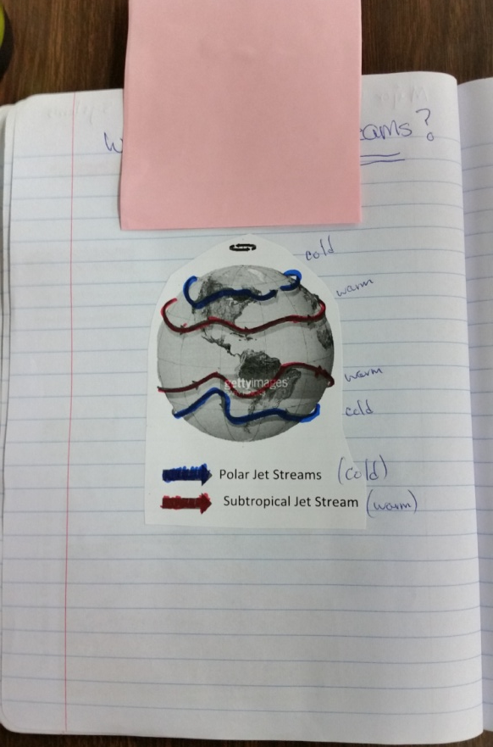

Slide 9
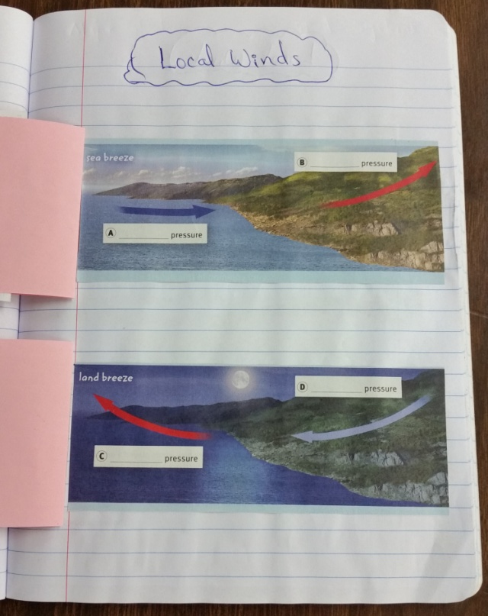
Pictures for Land-breeze and Sea-breeze are on pg 430

Slide 10
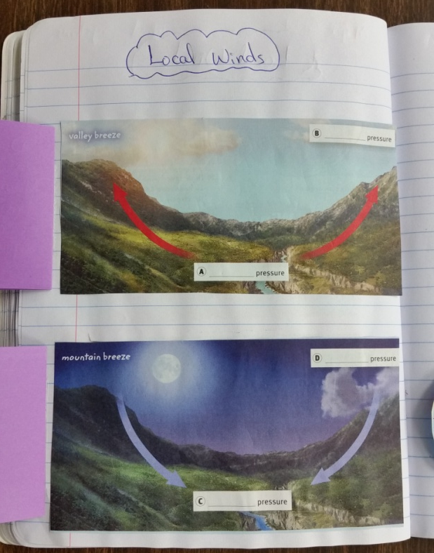
Copy this information inside your flip-book
Pictures for Valle-breeze and Mountain-breeze are in pg. 431

Slide 11
The information is in pg. 438 in your science text book
This picture was taken from pg. 441 or from 457 (is the same picture)

Slide 12
Deep convection currents picture is found in pg 443
The information is in pg. 442

Slide 13
Both the pictures and information are on pg 461. Notice that the information was glued to the composition book first, and the pictures were taped (from the top) at the end

